Slide 1
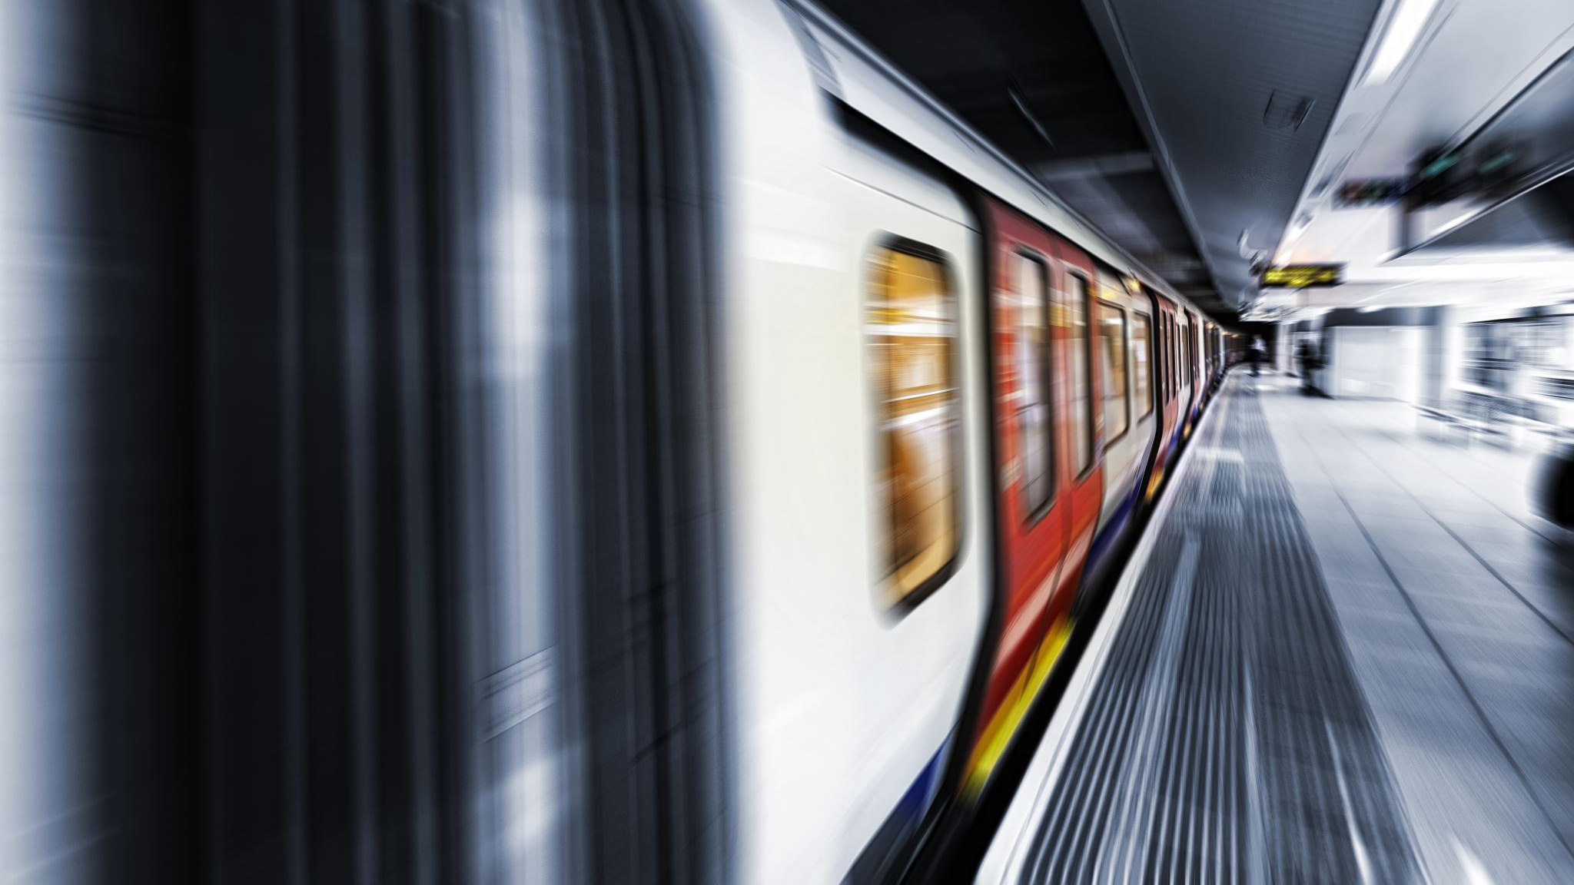
RAILWAY TICKET RESERVATION SYSTEM

Slide 2




TEAM MEMBERS: 1. B.UDAY KUMAR REDDY (12002775 ) 2. R.H.V.S Koushik(12002497) 3. P.V SAI KRISHNA TEJA(12001513) 4. V.SHESHU KUMAR(12003630)

Slide 3
Tags used in THE WEBSITE
TAGS | DESCRIPTION
<html> | Defines an HTML document
<head> | Contains metadata/information for the document
<title> | Defines a title for the document
<body> | Defines the document's body

Slide 4
TAGS | DESCRIPTION
<h1> to <h6> | Defines HTML headings
<p> | Defines a paragraph
<br> | Inserts a single line break
<hr> | Defines a thematic change in the content
<a> | Defines a hyperlink
<link> | Defines the relationship between a document and an external resource (most used to link to style sheets)
<ul> | Defines an unordered list

Slide 5
TAGS | DESCRIPTION
<ol> | Defines an ordered list
<li> | Defines a list item
<table> | Defines a table
<caption> | Defines a table caption
<th> | Defines a header cell in a table
<tr> | Defines a row in a table
<td> | Defines a cell in a table
<div> | Defines a section in a document
<script> | Defines a client-side script

Slide 6

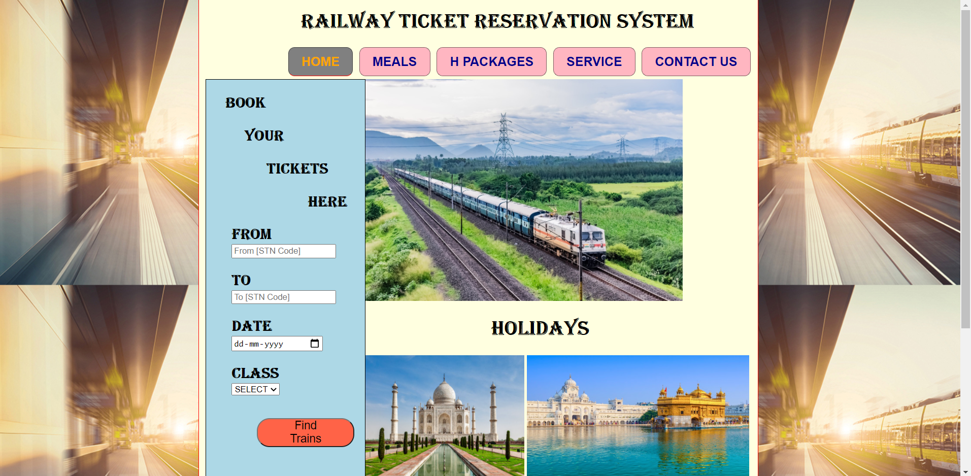
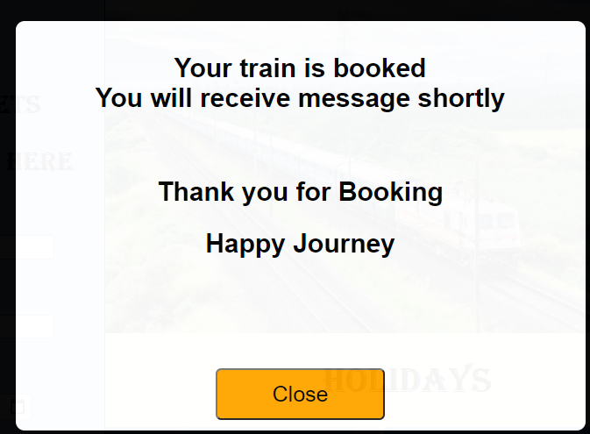
OUTPUT OF THE HOME PAGE:

Slide 7
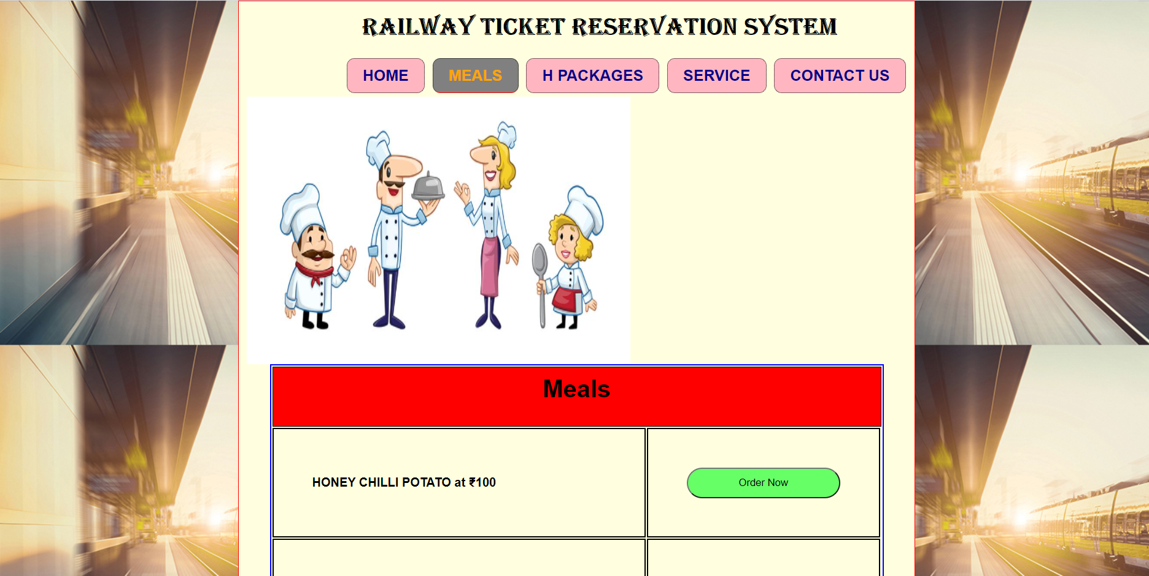
OUTPUT OF MEAL PAGE:

Slide 8
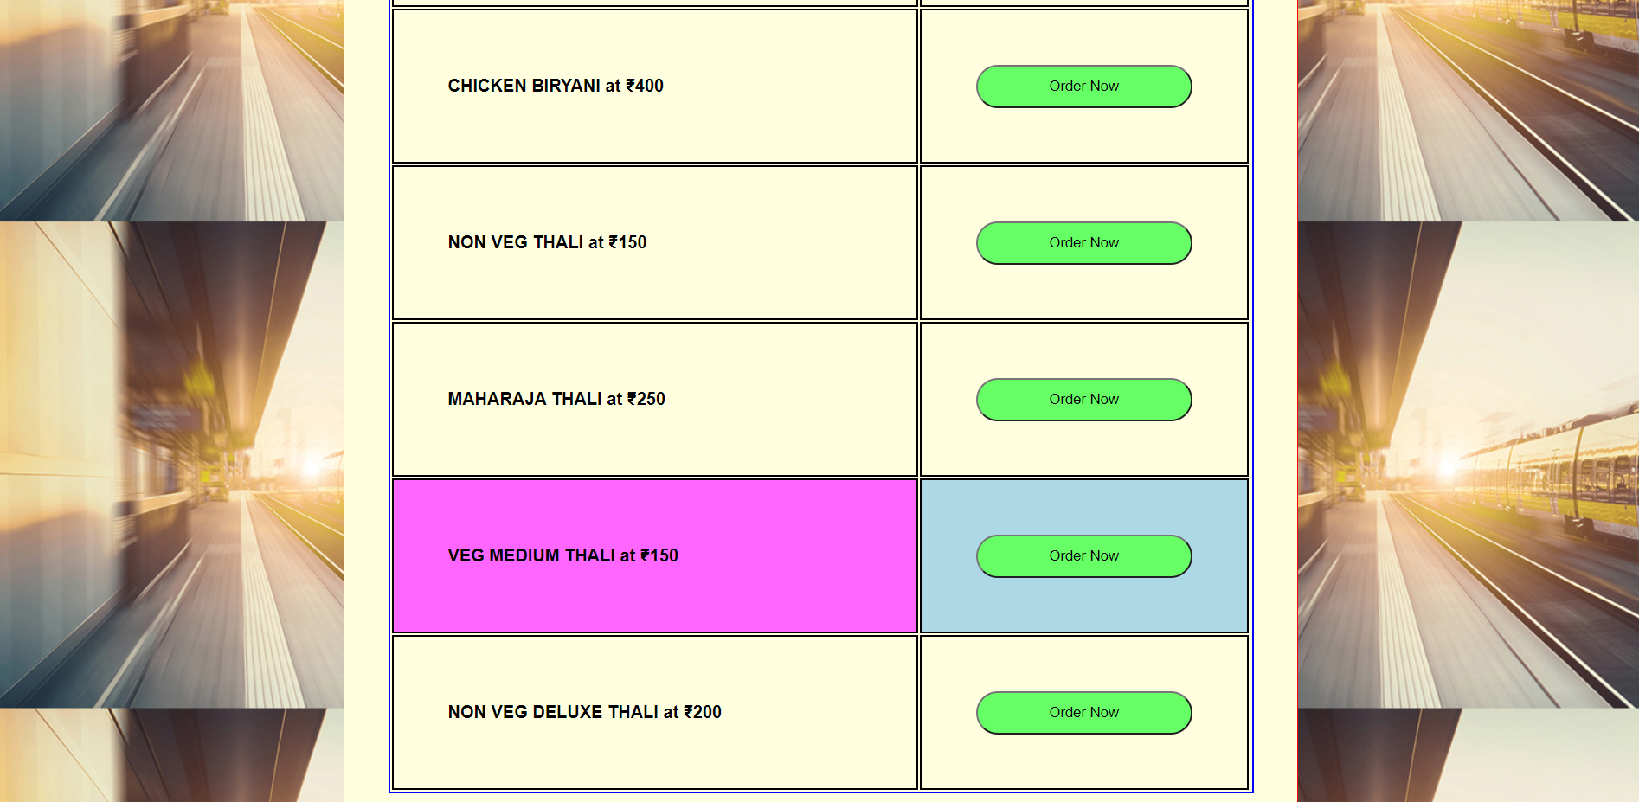

Slide 9
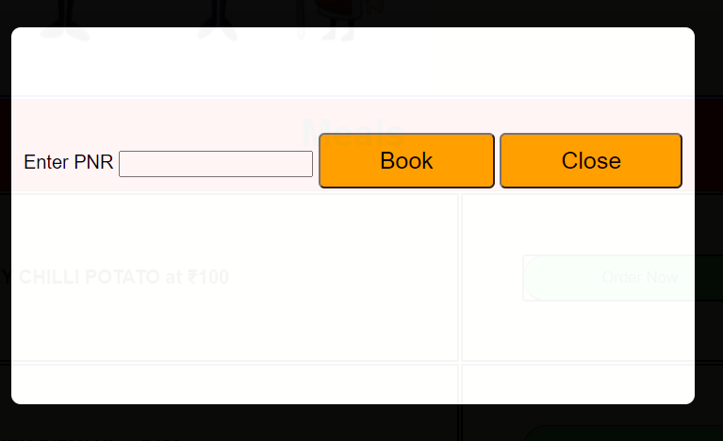
WHEN YOU CLICKED ON ORDER BUTTON

Slide 10
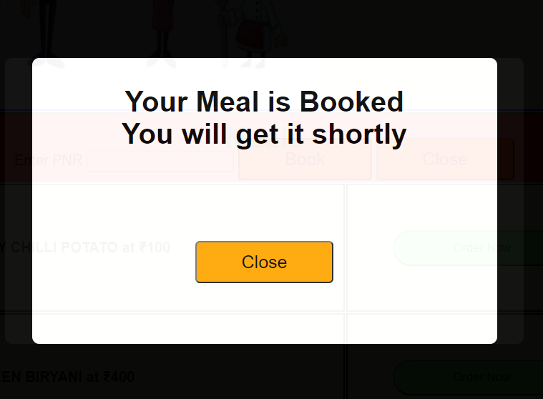
WHEN YOU CLICKED ON BOOK

Slide 11
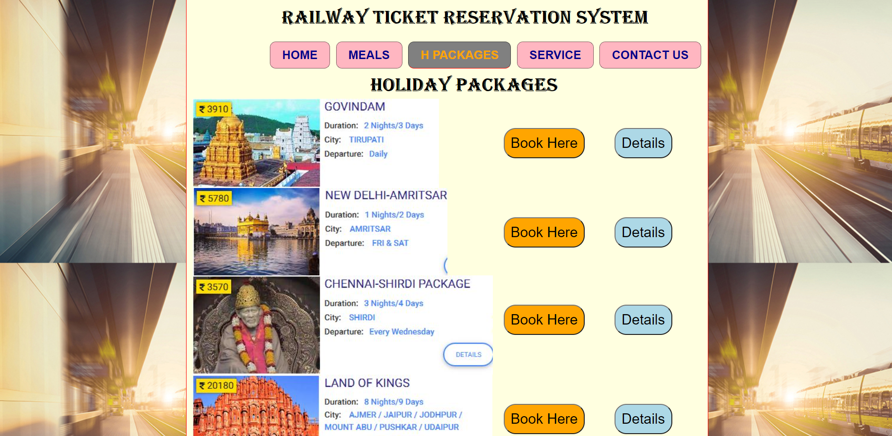
OUTPUT OF HOLIDAY PACKAGES:

Slide 12
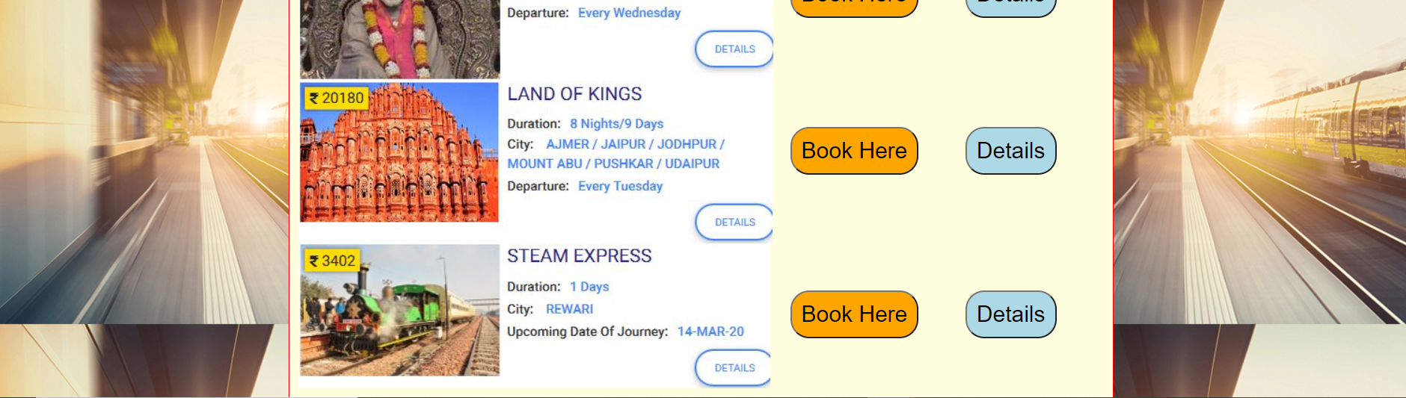

Slide 13
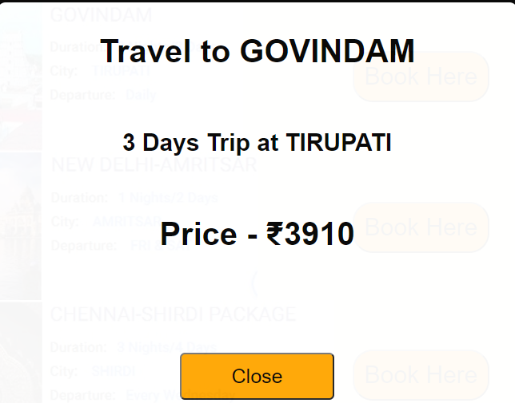
When You Click On the Details:

Slide 14
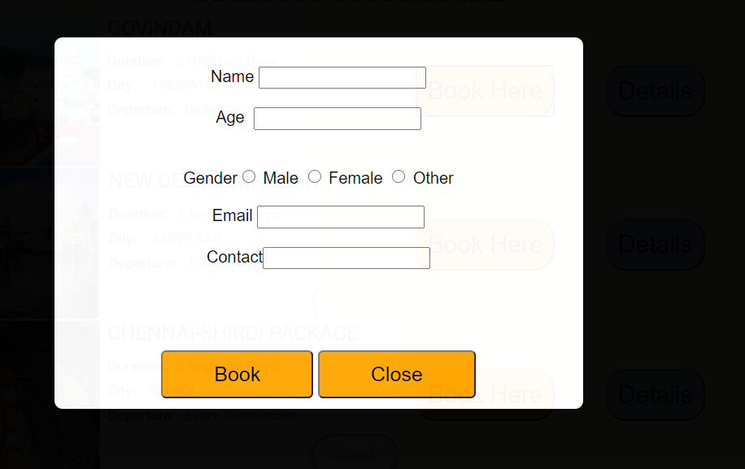
When you click on the BOOK HERE:

Slide 15
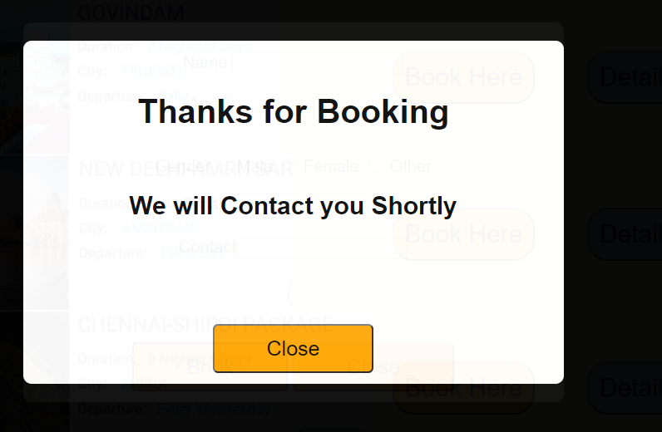
When You Click on the BOOK:

Slide 16
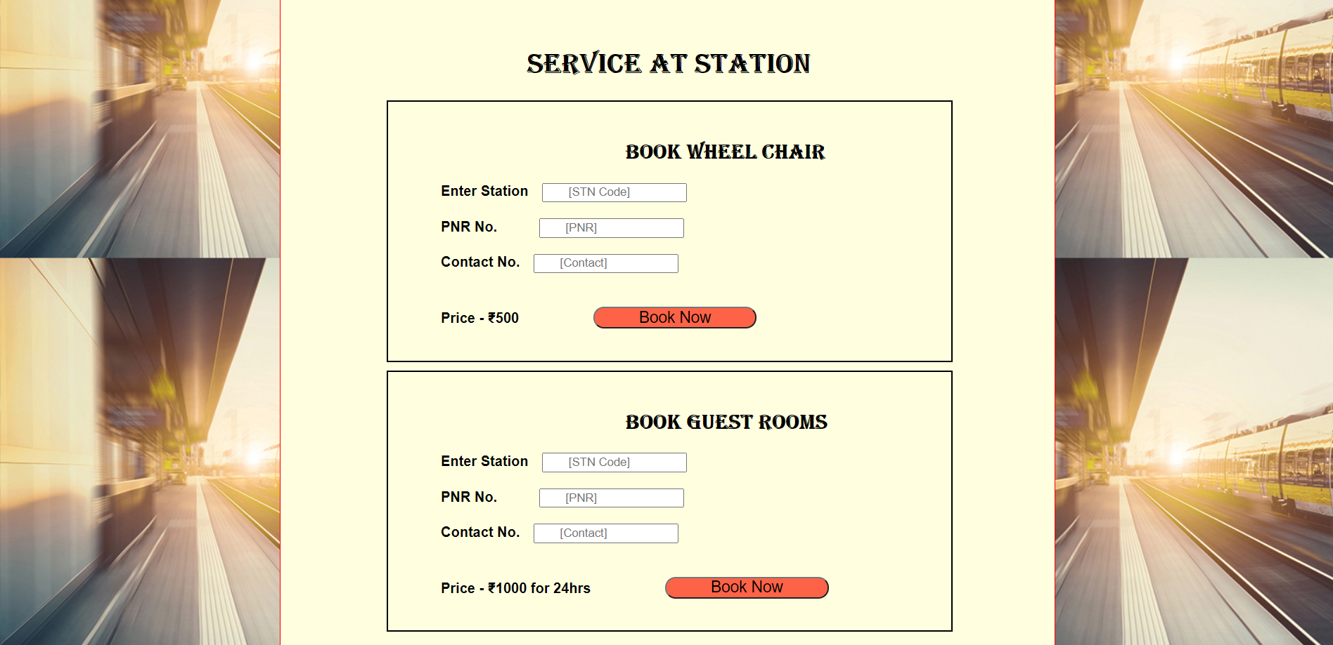
OUTPUT OF SERVICE PAGE:

Slide 17
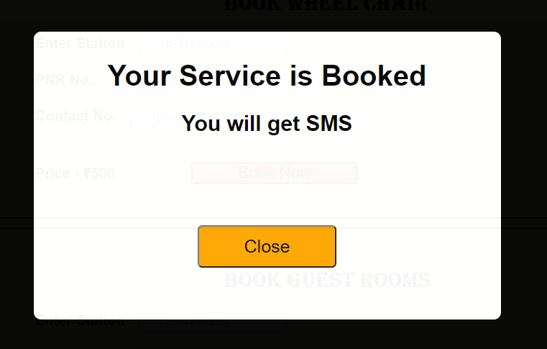
When you Click on the BOOK NOW;

Slide 18
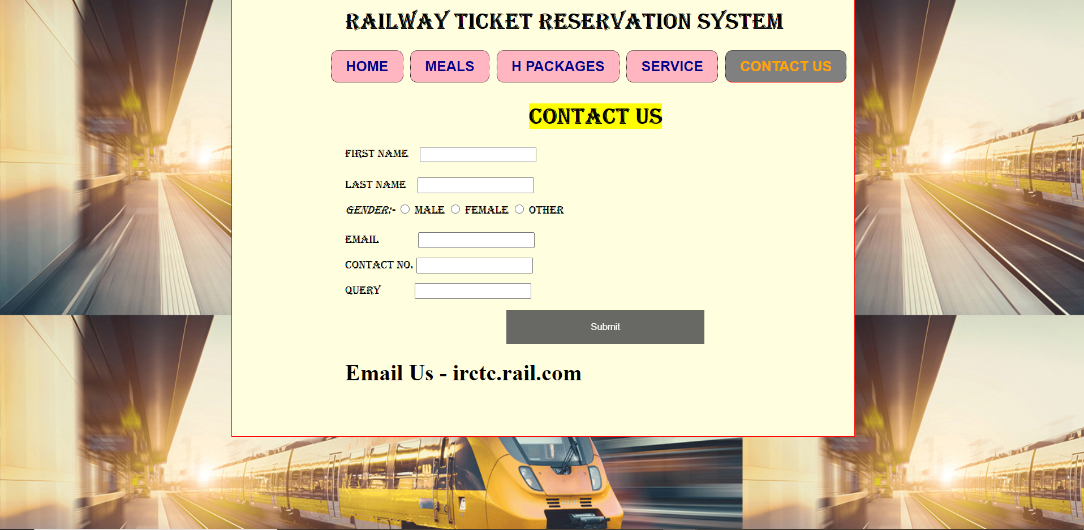
OUTPUT OF CONTACT PAGE:

Slide 19
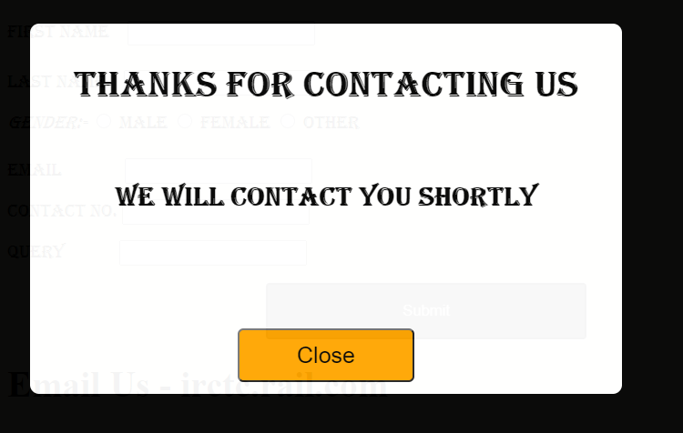
When You Click on the SUBMIT:

Slide 20
THANK YOU

